Slide 1
Pradhan Mantri Kaushal Vikas Yojana
Ms. Shruti Pandey, Deputy Director
^{Government of India}
Ministry of Skill Development and Entrepreneurship
^{29th March 2023}

Slide 2
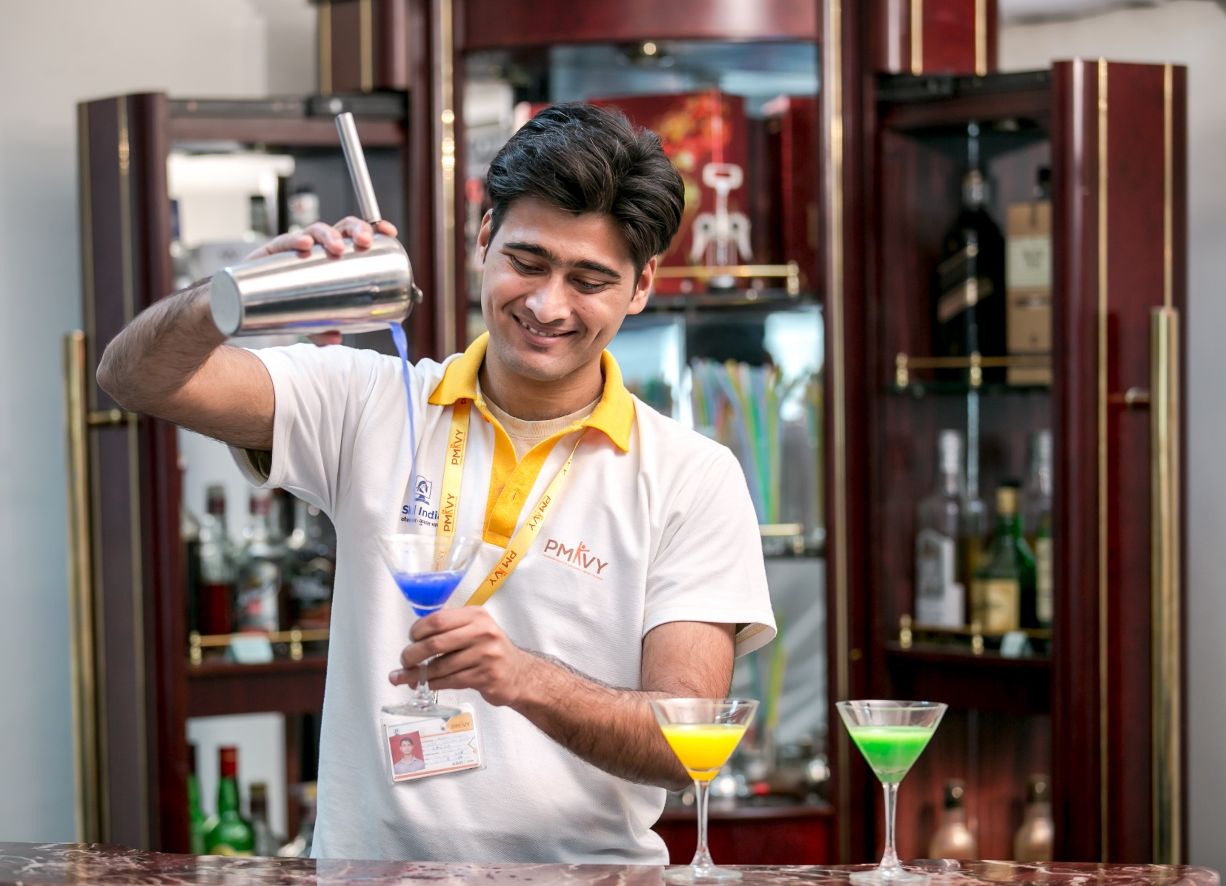
TABLE OF
CONTENT
Context Setting
Pradhan Mantri Kaushal Vikas Yojana
Skilling in Tourism Sector under PMKVY
Convergence in Skilling
Way Forward

Slide 3
Context Setting: Need for Skilling in Tourism and Hospitality Sector in India
“Our villages are becoming centers of tourism due to their improving infrastructure…Tourism has the same potential in the country as agriculture, real estate development, infrastructure and textile”
- Hon’ble Prime Minister
Tourism sector is expected to contribute 512 Billion USD to India's GDP by 2028
In FY20, tourism sector in India accounted for 39 Million jobs, which was 8.0% of the total employment in the country. By 2029, it is expected to account for ~53 Million jobs
Over the last 8.5 years, India has built extensive tourism infrastructure worth ~1 Billion USD
Travel and tourism is the third largest foreign exchange earner for India
Creating the Need for Skilling, Reskilling and Upskilling

Slide 4
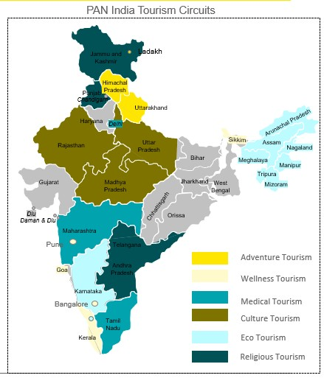
Tourism in India offers diversity and may require customised skilling solution
Types of tourism | Key Job roles
Adventure Tourism | Paragliding coach, skydiving instructor, Scuba diving instructor, Ski coach
Wellness Tourism | Wellness expert, Rejuvenation Expert, SPA manager
Medical Tourism | Medical tourism facilitator, Medical tourist translator
Eco-Tourism | Environmental educator, Eco tourist tour guide, Naturalist
Cultural Tourism | Heritage Tour Guide, Museum or gallery curator, Archaeologists, Digital guides etc.
Religious Tourism | Religious Tourist guide, Religious tour vehicle driver
Sports Tourism | Sports Marketer
Film Tourism | Travel coordinator, health & safety admin coordinator
Cruise Tourism | Hotel Facilities (cabin crew, housekeeping, reception, manager, butlers, chef, waiters; Leisure Center (instructors, lifeguards, activity leaders, etc.); Gym (personal trainers)
Staycations | Chiefs, room attendant, housekeepers

Slide 5
Pradhan Mantri Kaushal Vikas Yojana (1/2)
PMKVY was launched in 2015 under Skill India Mission with the objective of imparting short duration skill development training and certification to youth for making them employable for better livelihood
PMKVY has three training components, namely, Short Term Training (STT), Special Projects, and Recognition of Prior Learning (RPL)
Salient Features of PMKVY:
Create a demand driven ecosystem
for the youth to make informed choices on the available skilling avenues
Provide avenues to youth for skill training and certification, with planning from below instead of top down
Promote long-term sustainable Skill Centres and creation of Centre of Excellences through greater participation of private sector.

Slide 6
Pradhan Mantri Kaushal Vikas Yojana* (2/2)
4,500+
NSQF aligned courses
31,120+
Empanelled Training Centre
700+
Pradhan Mantri Kaushal Kendras
1.37 Lakh
Candidates
Trained
1.10 Lakh
Candidates Certified
109
Aspirational Districts Covered
36
Sector Skill Councils
*Data as on February 2023 for PMKVY 1.0, 2.0 and 3.0

Slide 7
Skilling in Tourism and Hospitality Sector under Pradhan Mantri Kaushal Vikas Yojana*
48
NSQF aligned Job roles
5,31,507
Candidates Trained
67,280
Candidates
Wage Employed
4,319
Apprentices Engaged
5
Sub-sectors Covered (Hotels, Restaurants, Facility Mgt, Cruise Liners, and Tour & Travel)
894
Training Centre offering Tourism and Hospitality related job roles
4,33,560
Candidates Certified
2,057
Candidates Self Employed
*Data as on February 2023 for PMKVY 2.0 and 3.0

Slide 8
Convergence in Skilling for Whole of Government Approach
Standardization through Common Cost Norms and NSQF aligned courses for skilling schemes of Central Ministries
Use of Skill India logo for branding and certification
On-the-Job training (OJT) for all candidates for smooth training to work transition (industry exposure)
Defined ToT and ToA for trainers and assessors to ensure quality through NCVET affiliated Awarding Bodies
Data from all skilling schemes of Central Ministries to converge on Skill India Portal
Cross-utilization of infrastructure of Central Ministries
Ensure Data, Policy, and Field-level Convergence

Slide 9
Way Forward: Convergence between MSDE and MoT will create a multiplier effect
Partnerships between IHMs, food Craft Institutes and TVET institutions in setting standards and imparting skill training and education in tourism sector at scale. Cross utilisation of infrastructure and convergence of schemes
Partner in creating a Trainer and Assessor Pool in Tourism domain
Co-creating digital content, MoT can partner with SIP and co-create content in tourism space
Co-funded skill training in emerging areas such as Cruise shipping, eco tourism, rural tourism, medical and wellness
Forge joint partnerships, especially with international agencies for training, assessment and certification
Joint research, studies and skill gap analysis in Tourism sector
1
2
3
4
5
6

Slide 10
Way Forward
On-Job-Training (OJT) is being made an integral part of short-term skilling in tourism sector
Flexibility in course curriculum with focus on digital content through blended mode of training delivery, special focus on new age, multi skilling courses and vernacular content.
Upskilling will be an essential aspect of the Recognition of Prior Learning programme with demands aggregated from industries in tourism and hospitality sector
More industry partnership linked skilling that enhances placement, improved curriculum design, training infrastructure, tools, etc. based on skill gap studies, will be given preference.
Skill Hubs to be an intrinsic part of PMKVY for integration with education through schools, colleges, HEIs, Universities, etc.

Slide 11
Thank you

